Slide 1




Company
Profile
PT Media Nikel Indonesia
www.nikel.co.id

Slide 2

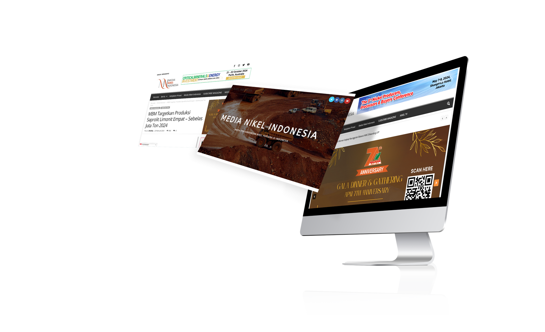


Contents
01
About us.
04
Coverage.
Campaign and content background
Uncovering every detail
02
Vision & Mission.
05
Clients.
Build a better tomorrow with our value
Empowering clients, elevating satisfaction
03
Our Service.
06
Let’s Connect.
From concept to creation
Open doors, endless possibilities
PT Media Nikel Indonesia
www.nikel.co.id

Slide 3


PT Media Nikel Indonesia
“Your Trusted Source for Insightful News and Analysis!”
Welcome to
Media Nikel Indonesia.
Leading the Charge in Nickel Mining News

Slide 4

PT Media Nikel Indonesia
About
Us
PT Media Nikel Indonesia is a media company focused on the nickel mining industry in Indonesia and globally. With extensive knowledge and experience in the industry, we have become a trusted source of information for industry players, investors, governments and the general public.

Slide 5


PT Media Nikel Indonesia
Vission
To be a leading partner in providing reliable and up-to-date information on the nickel mining industry in Indonesia and the world.
Providing Accurate & Reliable Information
Providing Information Media
Provide facilities for the promotion of nickel mining products & services
Mission

Slide 6




PT Media Nikel Indonesia
Service 01
Service 02
Magazines
Website
Our
Service
Service 03
Social Media

Slide 7







Magazines
Media Nikel Indonesia
1000+ Copies
2 Months
Daily orders from our costomers.
Publication of Media Nikel Indonesia Magazine
2 Years
40+
Years of working experience.
Number of Clients who have worked with Media Nikel Indonesia

Slide 8





Website
www.nikel.co.id
20k+
Monthly Active Users
10k+
Monthly Total Clicks
5k+
PAGE
VIEWS
380k+
Monthly Total Impressions

Slide 9

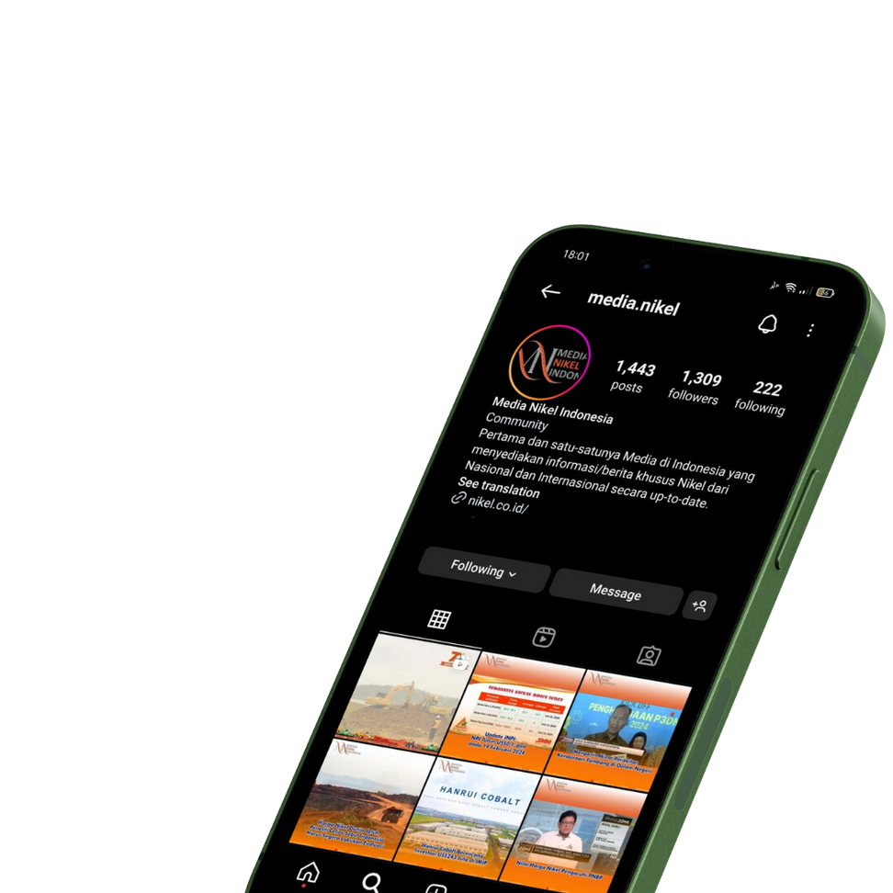




Social Media
487+
INSTAGRAM VIEWERS PER DAY
450+
LINKEDIN FOLLOWERS
1k+
INSTAGRAM FOLLOWERS

Slide 10
PT Media Nikel Indonesia
We send our magazine every 2 (two) months, to our clients and also our partners. Consists of:
Mining-related ministries
Mining Association
Member of the Indonesian Nickel Miners Association (APNI)
Mining Support Companies
Mining Events
Coverage

Slide 11

PT Media Nikel Indonesia
Client Who Have Trust On Us
50+
Get served

Slide 12




Let's
Connect
With Us!
www.nikel.co.id
+62 878-2606-1998
admin@medianikelindonesia.id

